Slide 1



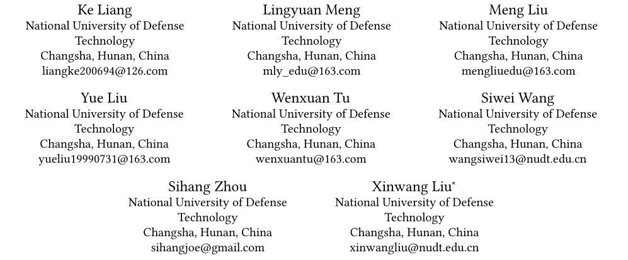
Learn from Relational Correlations and Periodic Events for
Temporal Knowledge Graph Reasoning
汇报人：吴宗錝
SIGIR（2023）

Slide 2

Contents.
01
02
Main work
Contribution
目录
03
04
Method
Experiment
05
Conclusion
知行合一、经世致用
Central South University

Slide 3
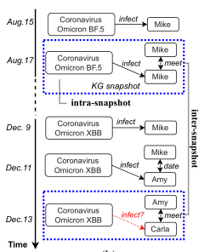

Main work
01
Reasoning on temporal knowledge graphs (TKGR), aiming to infer missing events along the timeline。
TKG？
K G？
interpolation reasoning
Extrapolation reasoning

Slide 4
Main work
01
The key to inferring future facts and events ：fully mine the information underlying the TKGs.
There are two types of information：
（1）intra-snapshot structural information
（2）inter-snapshot temporal interactions
Two main limitations exist in most of the previous models：
（1）as for the intra-snapshot information, these models fail to leverage the semantic correlations between relations.
（2）As for the inter-snapshot interactions, these models ignore mining the periodic temporal information along the timeline.
This paper:
propose a novel model（ termed RPC）, sufficiently mines the information underlying the Relational correlations and Periodic patterns via two novel Correspondence units, i.e., relational correspondence unit (RCU) and periodic correspondence unit (PCU).

Slide 5
Contribution
02
proposed a novel encoder-decoder extrapolation temporal relation reasoning model, termed RPC, which sufficiently mines the information underlying relational correlations and periodic patterns in TKGs.
The first to leverage the relational correlations intra-snapshot structural information for temporal knowledge graph reasoning via the relational correspondence unit (RCU).
Both sequential and periodic inter-snapshot temporal information is leveraged in this model.

Slide 6
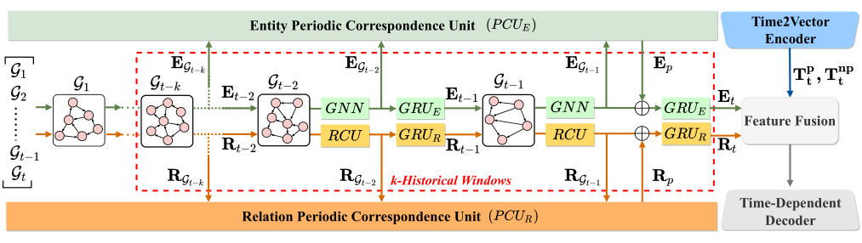
Method
03
3.guide the time-dependent decoder for fact scoring.
1.GNN and RCU are used to encode the intra-snapshot graph structural information for
entities and relations, respectively.
2.The GRU and PCU are designed for sequential and periodic inter-snapshot temporal interactions within the scope of k-Historical Windows, separately.

Slide 7



Method
03
1.Intra-snapshot Structural Representation Learning
1.1 One-Dimensional Convolution-based RGCN Encoder.
catenating
the embedding of entity eℎ and et of the lth layer at tth KG snapshot.
is a normalization constant.

Slide 8
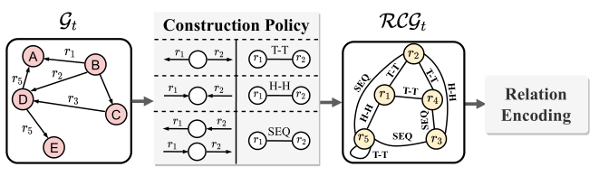
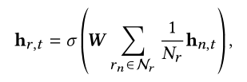

Method
03
1.Intra-snapshot Structural Representation Learning
1.2 Relational Correspondence Unit.
relational correlation graph (RCG) construction
RCG is an undirected graph where each node represents a relationship in the corresponding G.
relational encoding
set of connected nodes in RCG for relation r

Slide 9
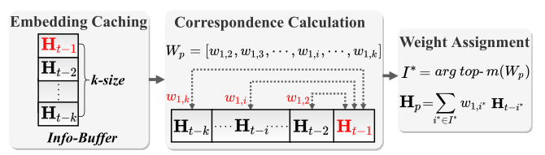
Method
03
2. Inter-snapshot Temporal Interaction Modeling
2.2 Relational Correspondence Unit.
Embedding caching, correspondence calculation, and weight assignment
Embedding caching aims to store the embeddings of the snap-
shots at the latest k timestamps cropped by k-Historical Window
the correspondence weights between the representation of each cropped snapshot with the latest snapshot, i.e., H−1, are calculated based on the similarity function in the correspondence calculation procedure.

Slide 10

Method
03
3. Inter-snapshot Temporal Interaction Modeling
Time-Dependent Decoder.
Time-ConvTransE
matrix for linear transformation
feature mapping operation
fused representation
the initial embedding

Slide 11
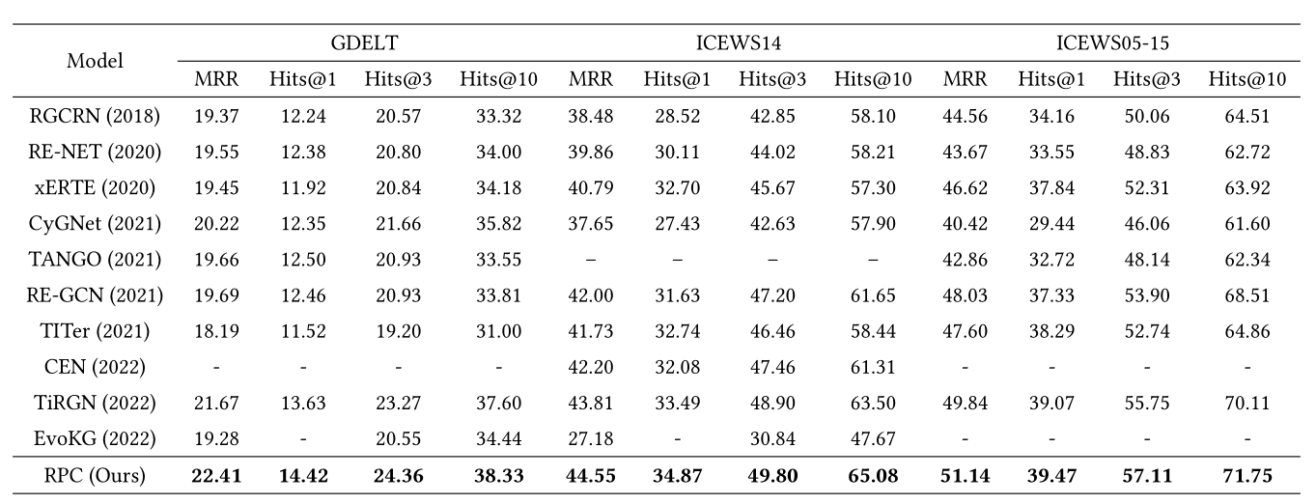
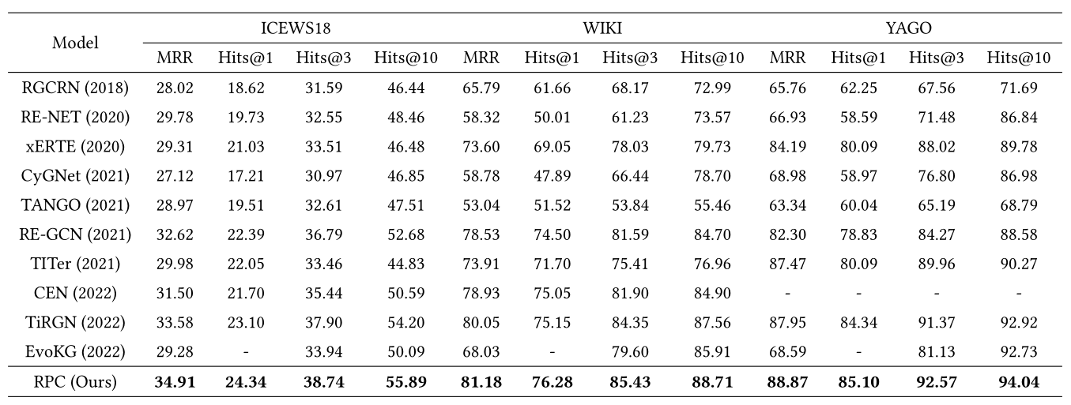




















Experiment
04

Slide 12
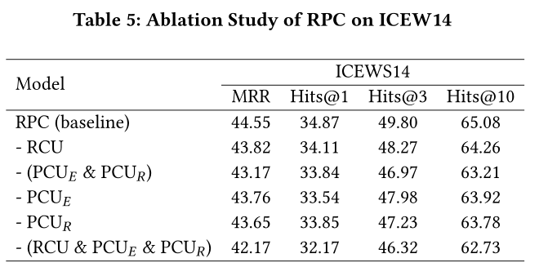
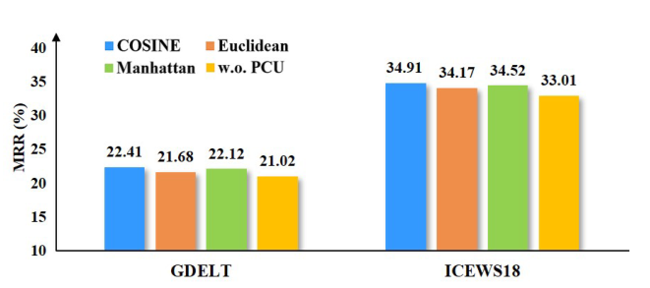
Experiment
04

Slide 13
Conclusion
07
Propose a novel encoder-decoder TKGR model, termed RPC, for extrapolation reasoning. It can sufficiently mine the information underlying the Relational correlations and Periodic patterns via two novel Correspondence units, i.e., relational correspondence unit (RCU) and periodic correspondence unit (PCU).
The time series is also preset in our data set, and some cyber threat behaviors also have very obvious periodicity.

Slide 14

THANKS

